Slide 1
DEPARTMENT OF MECHANICAL ENGINEERING SUB CODE -18MES103L SUB.NAME-BASIC CIVIL & MECHANICAL ENGINEERING WORKSHOP
EXPERIMENT 2
SCOOP MAKING USING GI SHEET

Slide 2
AIM OF THE EXPERIMENT
To make a Big Scoop of given size from a sheet metal piece.

Slide 3
APPARATUS REQUIRED
1) Steel rule
2) Scriber
3) Steel square
4) Straight snip
5) Anvil or Bench plate
6) Mallet

Slide 4
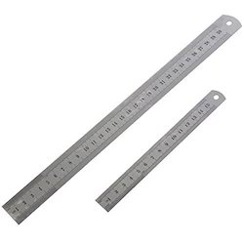
Steel RuIe
The rule is a strip of metal graduated in inches and fractions of an inch to give actual measurements.
When tolerances of fractional dimensions are required, the steel rule is used.

Slide 5
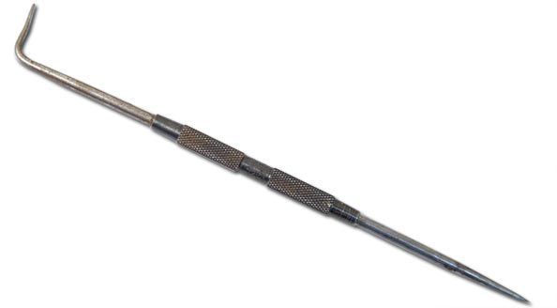
Scriber
A scriber is a hand tool used in metal work to mark lines on workpieces, prior to machining.
The process of using a scriber is called scribing and is just part of the process of marking out.
It is used instead of pencils or ink lines, because the latter are hard to see, easily erased, and imprecise due to their wide mark; scribe lines are thin and semi-permanent.

Slide 6
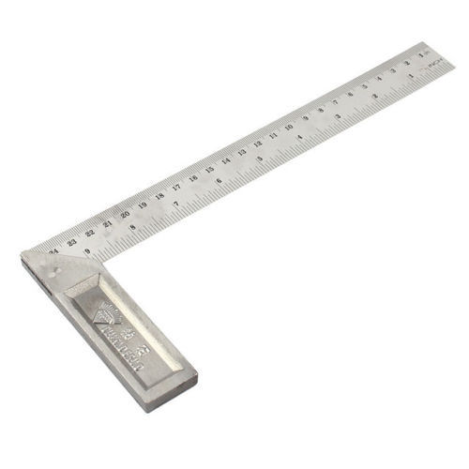
Try Square
A try- square is a woodworking tool used for marking and measuring a square piece of wood.
The square refers to the tool's primary use of measuring the accuracy of a right angle (90 degree angle); to try a surface is to check its straightness or correspondence to an adjoining surface.

Slide 7
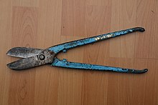
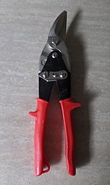
Straight snips
Straight snips are used for cutting a straight line and for curves having a large radius. Bent snips are used in cutting small curves.

Slide 8
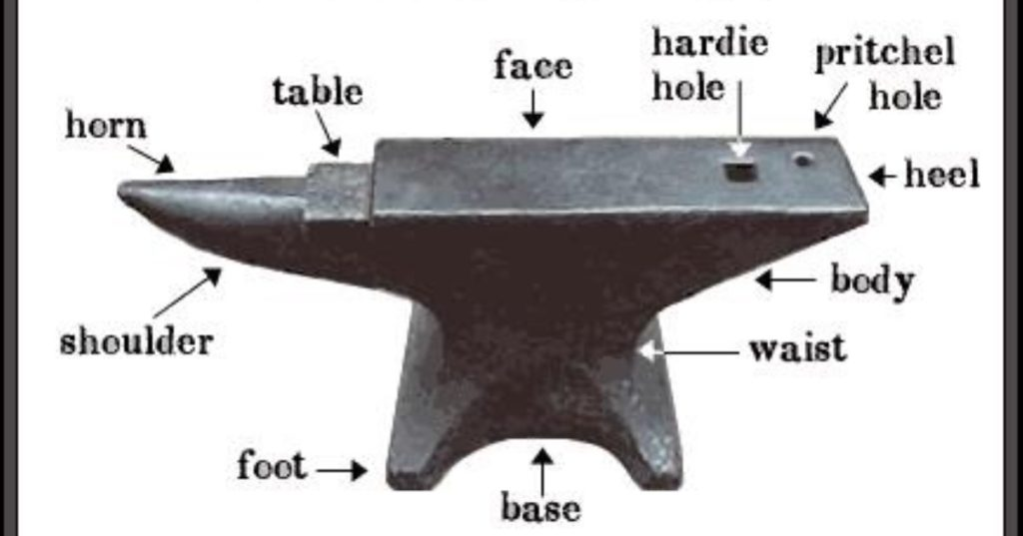
Anvil or Bench plate
An anvil is a metalworking tool consisting of a large block of metal (usually forged or cast steel), with a flattened top surface, upon which another object is worked

Slide 9
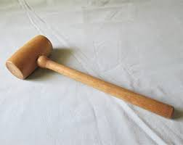
Wooden mallets
Wooden mallets are usually used in carpentry to knock wooden pieces together, or to drive dowels or chisels.
A wooden mallet will not deform the striking end of a metal tool, as most metal hammers would.
It is also used to reduce the force driving the cutting edge of a chisel, giving better control.
Hardwood mallets are also used to knock in cricket bats.

Slide 10
SEQUENCE OF OPERATIONS
I. Checking
II. Layout Marking
III. Shearing
IV. Folding
V. Locking and Seaming

Slide 11
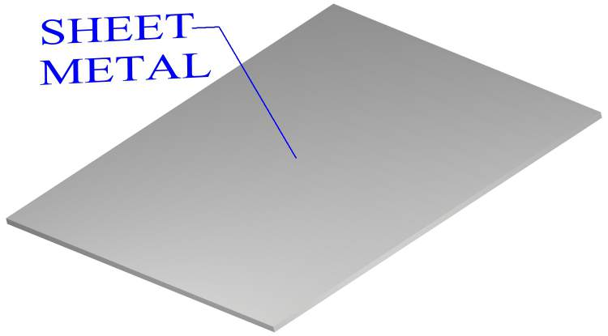
PROCEDURE
I. Checking
1. Check whether the given sheet is having its dimension as 200mm x 150mm. If the dimension is excess trim off using hand shear.
2. Keep one corner of the sheet between body and tongue of Steel Square and check whether the sides exactly coincide with Steel Square.
3. Keep this corner as reference corner and these two sides as reference sides. This corner should be kept at left hand side bottom position.

Slide 12
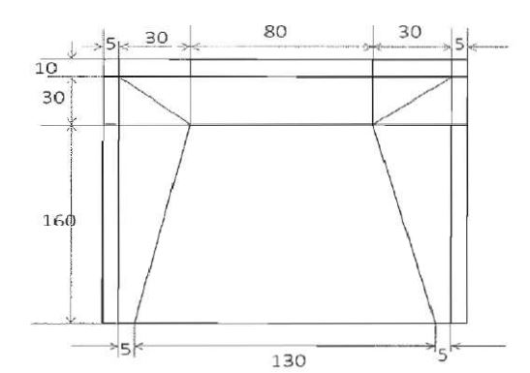
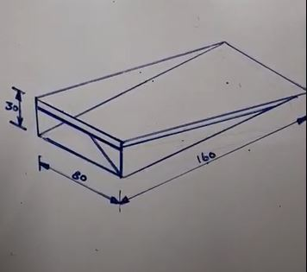
PROCEDURE
II. Layout Marking
Using steel rule and scriber mark 5mm point on both sides in vertical axis.
b) Mark 5mm on one side of the horizontal axis and then again make a point mark after 60mm from first 10mm.
c) Now from 5mm marking mark 10mm on both end in vertical axis.
d) Make two diagonal line attaching on joining 60mm marking on horizontal axis to 10mm marking on vertical axis

Slide 13
PROCEDURE
III. Shearing
Keep the pattern over square stake such that the line at hem portion I exactly coincides with edge of the stake.
b) Fold the 5mm marking 180 deg on anvil or both sides of sheet pattern in inner direction.
c) Now fold 90 deg the horizontal from 60mm marking.
IV. Folding
a) Make a shape on A shaped part in one square and B in other square.
b) Now use a straight snip off unwanted portion ( A & B )
c) Now fold the two sides of sheet from the diagonal line 90 deg.

Slide 14
PROCEDURE
V. Locking and Seaming
a) Now join the two edge portion A & B from the 60mm 90 deg folded from V horizontal axis and grip and lock them.
b) Check for the dimensions of the complete scoop
RESULT
Thus the required scoop is made out of the given sheet metal piece.

